Slide 1
Global States
&
Global Snapshots with
Termination Detection (preliminaries)

Slide 2
Global States
It is often desirable to determine whether a particular property is true of a Distributed System or not.
Definition: It consists of the local state of each process, together with the message that are currently in transit, that is, that have been sent but not delivered.
A Global State predicate is a function that maps from the set of Global State of processes in the Distributed System to {True, False}.
Some application areas of the Global State of the Distribute System are:
Garbage Collection, Deadlock Detection,Termination Detection,
Debugging

Slide 3
Global Snapshots
Definition: A distributed snapshot reflects a state in which the distributed system might have been.
An important property is that such a snapshot reflects a consistent global state.
The notion of a global state can be graphically represented by CUT.
Cuts provide the ability to assemble a meaningful Global State from the Local States recorded at different times.

Slide 4
Why take a Global Snapshot?
p
p
2
1
(Distributed)
Garbage collection
object
reference
message
garbage object
p
wait-for
p
2
1
b. (Distributed)
Deadlock Detection
wait-for
1
p
2
p
activate
c. Termination Detection
passive
passive
d. Distributed Debugging
Two variables X₁ & X₂ residing at the process P₁ &
P₂, can it be said whether |X₁-X₂|>δ is ever true!

Slide 5
Distributed Snapshot
A computation is a sequence of atomic actions that transform a given initial state to the final state. While such actions are totally ordered in a sequential process, they are only partially ordered in a distributed system.
The state (also known as global state) of a distributed system is the set of local states of all the component processes, as well as the states of every channel through which messages
flow.

Slide 6
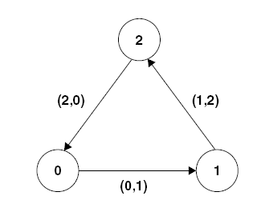
Difficulties in global calculation
Consider a system of three processes numbered 0, 1, and 2 connected by FIFO channels, and assume that an unknown number of indistinguishable tokens are circulating indefinitely through this network.
We want the processes to cooperate with one another to count the exact number of tokens circulating in the system (without ever stopping the system).
The task has to be initiated by an initiator process (say process 0) that will send query messages to the other processes to record the number of tokens sighted by them.

Slide 7
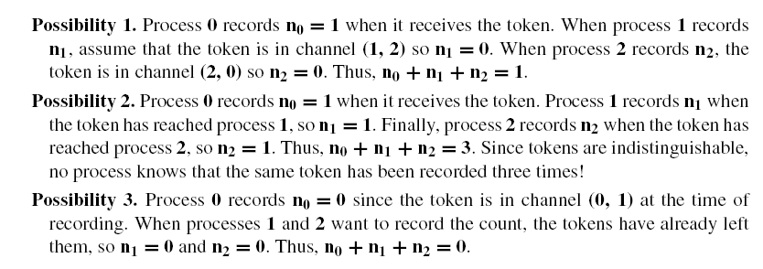
Possibilities

Slide 8
Properties of Consistent Snapshots
A snapshot state (SSS) consists of a set of local states, where each local state is the outcome of a recording event that follows a send, or a receive, or an internal action.
Cuts and Consistent Cuts: A cut is a set of events—it contains at least one event per process.

Slide 9
Process history
For a process P_{i} , where events e_{i}⁰, e_{i}¹, … occur:
history(P_{i}) = h_{i} = <e_{i}⁰, e_{i}¹, … >
prefix history(P_{i}^{k}) = h_{i}^{k} = <e_{i}⁰, e_{i}¹, …,e_{i}^{k} >
S_{i}^{k} : P_{i} ’s state immediately before k^{th} event
e₁⁰
e₁¹
e₁²
e₁³
P1
e₂¹
P2
e₂⁰
e₂²
P3
e₃⁰
e₃¹
e₃²
Dept. of IT, Jadavpur University

Slide 10
Global history and cuts
For a set of processes P₁ , …,P_{i} , …. :
global history: H = ∪_{i} (h_{i})
global state: S = ∪_{i} (S_{i}^{k}i)
cut C ⊆ H = h₁^{c1} ∪ h₂^{c2} ∪ … ∪ h_{n}^{cn}
frontier of C = {e_{i}^{ci}, i = 1,2, … n}
(Last state in each process.)
e₁⁰
e₁¹
e₁²
e₁³
P1
e₂¹
P2
e₂⁰
e₂²
P3
e₃⁰
e₃¹
e₃²
Dept. of IT, Jadavpur University
Note: Global state does not record the state of the channels separately

Slide 11
Consistent States(1/3)
Lamport’s “happens-before”
A cut C is consistent if and only if
∀e ∈ C (if f → e then f ∈ C)
A global state S is consistent if and only if
it corresponds to a consistent cut
e₁⁰
e₁¹
e₁²
e₁³
P1
e₂¹
P2
e₂⁰
e₂²
P3
e₃⁰
e₃¹
e₃²
Consistent cut
Inconsistent cut (shows ‘effect’ without ‘cause’)
Notes:
Boundary – to the right and to the left
Consistent Cut = global state (process states and messages)

Slide 12
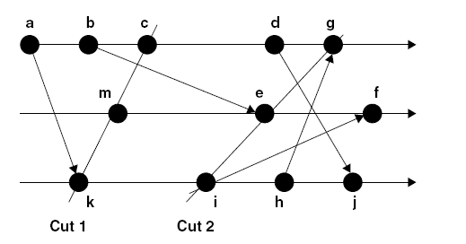
Consistent States(2/3)
Here {c, d, g, f, h} is a cut.

Slide 13
Consistent States(3/3)
A cut is called consistent, if for each event that it contains, it also includes all events causally ordered before it. Let a, b be two events in a distributed system. Then
(a ∈ consistent cut C) ∧ (b ≺ a) ⇒ b ∈ C
Thus, for a message m, if the state following receive (m) belongs to a consistent cut, then the state following send (m) also must belong to that cut.
Cut 1 = {a, b, c, m, k} is consistent, but Cut 2 = {a, b, c, d, g, m, e, k, i} is not, since (g ∈ Cut 2) ∧ (h ≺ g), but h does not belong to Cut 2. As processes make progress, new events update the consistent cut.
The set of local states following the most recent events (an event a is a most recent event, if there is no other event b such that a ≺ b) of a cut defines a snapshot.

Slide 14
Snapshots
The set of local states following the recorded recent events of a consistent cut forms a consistent snapshot.
Let C1 and C2 be two consistent cuts inducing two different snapshots S1 and S2, respectively, and let C1 ⊂ C2. Then, C2 is more recent than C1. Accordingly, the snapshot S2 is more recent than the snapshot S1.

Slide 15
System Execution
An execution of a distributed system is a sequence of transitions between consistent global states of the system S₀ -> S₁ -> S₂ -> S₃
  In each transition one event occurs at some single process
e₁⁰
e₁¹
e₁²
e₁³
P1
e₂¹
P2
e₂⁰
e₂²
P3
e₃⁰
e₃¹
e₃²
C0
(S0)
C1
(S1)
C2
(S2)
C3
(S3)

Slide 16
Runs & Linearization
A run is a total ordering of events in H that is consistent with each h_{i}’s ordering
  E.g., <e₁⁰, e₁¹, e₁², e₁³, e₂⁰, e₂¹ , e₂², e₃⁰ e₃¹, e₃²>
A linearization is a run consistent with happens-before (→) relation in H
  E.g., < e₁⁰, e₁^{1,} e₃⁰, e₂⁰ ,…>, < e₁⁰, e₃⁰ , e₁¹, e₂⁰ , …>
  Concurrent events are ordered arbitrarily
  Linearizations pass through consistent global states
e₁⁰
e₁¹
e₁²
e₁³
P1
e₂¹
P2
e₂⁰
e₂²
P3
e₃⁰
e₃¹
e₃²
C0
C1
C2
C3

Slide 17
Goal of Chandy & Lamport
The goal of the algorithm is to record a set of processes and channel states ( a snapshot) for a set of processes such that even though the combination of recorded states may never have occurred at the same time , the recoded global state is consistent.

Slide 18
Chandy-Lamport “Snapshot” Algorithm(1/3)
“Snapshot” is a set of process and channel states for set of processes P_{i} (i=1,…N) such that the recorded global state is consistent
  Even those the combination of recorded states may never occurred at the same time
Chandy-Lamport Algorithm records a set of process and channel states such that the combination is a consistent global state.
Assumptions:
  No failure, all messages arrive intact, exactly once
  Communication channels are unidirectional and FIFO-ordered
  There is a comm. channel between each pair of processes
  Any process may initiate the snapshot (send “Marker”)
  Snapshot does not interfere with normal execution

Slide 19
Chandy-Lamport Snapshot Algorithm (2/3)
Initiator process P₀ records its state locally
Marker sending rule for process P_{i}:
  After P_{i} has recorded its state, for each outgoing channel Ch_{ij}, P_{i} sends one marker message over Ch_{ij} (before P_{i} sends any other message over Ch_{ij})
Marker receiving rule for process P_{i}:
  Process P_{i} on receipt of a marker over channel Ch_{ji}
  If (P_{i} has not yet recorded its state) it
  Records its process state now;
  Records the state of Ch_{ji} as empty set;
  Starts recording messages arriving over other incoming channels;
else (P_{i} has already recorded its state)
P_{i} records the state of Ch_{ji} as the set of all messages it has
received over Ch_{ji} since it saved its state

Slide 20
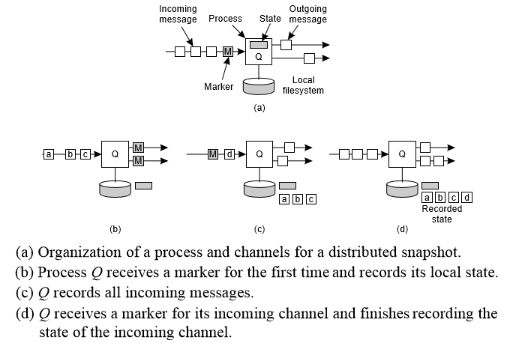
Chandy-Lamport Snapshot Algorithm (3/3)

Slide 21
Snapshot Example
e₁⁰
e₁^{1,2}
e₁³
e₁⁴
e₁³
P1
M
M
a
M
e₂³
e₂⁴
M
P2
e₂⁰
e₂^{1,2,3}
M
M
b
P3
e₃⁰
e₃^{2,3,4}
e₃¹
1- P1 initiates snapshot: records its state (S1); sends Markers to P2 & P3; turns on recording for channels Ch₂₁ and Ch₃₁
2- P2 receives Marker over Ch₁₂, records its state (S2), sets state(Ch₁₂) = {} sends Marker to P1 & P3; turns on recording for channel Ch₃₂
3- P1 receives Marker over Ch₂₁, sets state(Ch₂₁) = {a}
4- P3 receives Marker over Ch₁₃, records its state (S3), sets state(Ch₁₃) = {} sends Marker to P1 & P2; turns on recording for channel Ch₂₃
5- P2 receives Marker over Ch₃₂, sets state(Ch₃₂) = {b}
6- P3 receives Marker over Ch₂₃, sets state(Ch₂₃) = {}
7- P1 receives Marker over Ch₃₁, sets state(Ch₃₁) = {}

Slide 22
Global snapshot algorithm by Chandy and Lamport
Some properties:
  Computes a consistent global state in a distributed manner. Actually the global state recorded “could have” happened.
  Algorithm can be initiated by any process or by several processes concurrently.
  Message complexity = O(|E|) where E is the set of channels.
  Each initiation needs its own unique marker (e.g. <pid, seqno>).
    Each process has a unique “pid”
    Different initiations by the same process has different “seqno.”
  Algorithm terminates in finite time if each process ensures
    [C1] no marker remains forever in an incident input channel
    [C2] it records its state within finite time of initiation of the algorithm
  A simple way to collect all the recorded information is for each process to send the information it recorded to the initiator of the recording process. The initiator can be easily identified by the marker.
  Alternatively, each process can send the information it records along each outgoing channel. Each process receiving it for the first time copies it and propagates it along all outgoing channels. All processes (if the topology is a strongly connected graph) get all the recorded information in finite time and can determine the recorded global state.
Dept. of IT, Jadavpur University

Slide 23
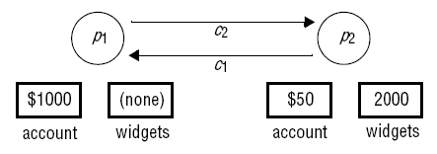
Another Example: Trading
Process p₂ has already received an order for 5 widgets, which it will shortly dispatch to p₁ .

Slide 24
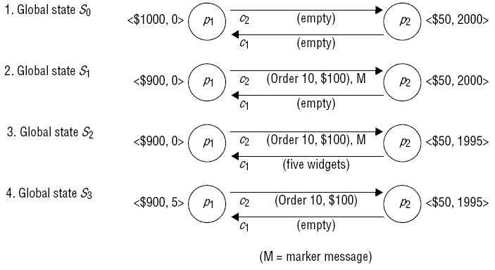
Execution of the Processes

Slide 25
Counting of tokens.(1/2)
1. Process 0 sends out the token turns red, records n0 = 0, sent(0, 1) =
1, received(2, 0) = 0, and sends the marker along (0, 1).
2. Process 1 receives the token and forwards it along (1, 2) before receiving the marker.
3. Process 1 receives the marker, turns red, records n1 = 0, received(0, 1) = 1, sent(1, 2) = 1, and sends the marker along (1, 2).
4. Process 2 receives the token and forwards it along (2, 0) before receiving the marker.

Slide 26
Counting of tokens.(2/2)
5. Process 2 receives the marker, turns red, records n2 = 0 received(1, 2) = 1, sent (2, 0) = 1, and forwards the marker to process 0.
6. Process 0 receives the token and then receives the marker along (2, 0).
The algorithm terminates here. The total number of tokens recorded = n0 + n1 + n2 + sent(0, 1) − received(0, 1) + sent(1, 2) − received(1, 2) + sent(2, 0) − received(2, 0) = 1.

Slide 27
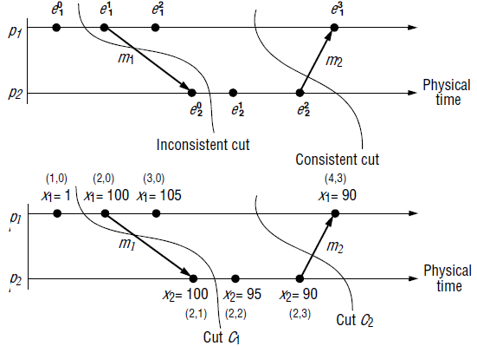
Distributed Debugging:
Observation of consistent Global States(1/2)

Slide 28

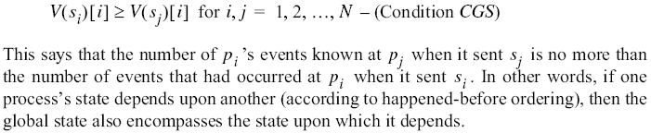
Distributed Debugging:
Observation of consistent Global States(2/2)
Vector timestamps and variable values for the execution of above Figure.
The requirement is |X₁-X₂| ≤ 50. For C₁ it is violated but for C₂ it is followed.

Slide 29
Conclusion
The distributed snapshot algorithm clarifies what constitutes the global state of a distributed system when the clocks are not synchronized, or processes do not have clocks.
An alternative suggestion is to freeze the entire system, record the states of the processes, and then resume the computation. However, a global freeze interferes with the ongoing computation, and is not acceptable in most applications.
Additionally, any algorithm for freezing the entire system
requires the propagation of a freeze signal across the system, and will be handled in a manner similar to the marker.
.

Slide 30
Final Remarks
The snapshot algorithm captures the fragments of a consistent global state in the various component processes.
It requires another broadcast algorithm (or state collection algorithm) to put these fragments together into a consistent global state and store it in the state space of the initiator.

Slide 31
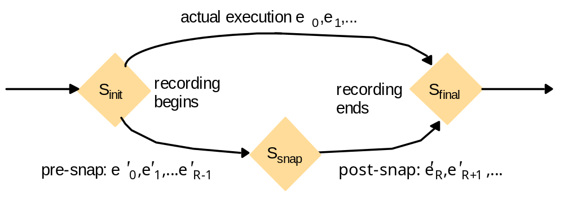
Reachability between States in Snapshot Algorithm
Let e_{i} and e_{j} be events occurring at p_{i} and p_{j}, respectively such that e_{i} → e_{j}
The snapshot algorithm ensures that
if e_{j} is in the cut then e_{i} is also in the cut.
if e_{j} occurred before p_{j} recorded its state, then e_{i} must have occurred before
p_{i} recorded its state.

Slide 32

Global State & Global Snapshot
Counting Camels
  Satellites cover the entire area of interest
  Each satellite can count the number of camels in its zone
  How to compute the total number of camels?
This is the Global State Problem

Slide 33
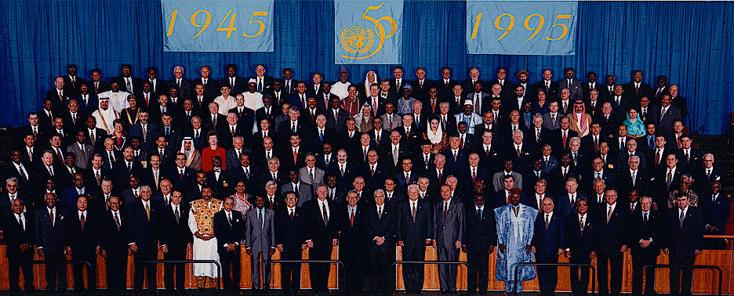
Example of a Global State
[United Nations photo by Paul Skipworth for Eastman Kodak Company ©1995 ]

Slide 34
Termination Detection Algorithms (1/2)
If a process Q receives the marker (m) requesting a snapshot for the first time, it considers the process that sent the marker as its predecessor.
When Q completes its part of snapshot, it sends a DONE message.
When the initiator/monitor process say P receives DONE message from all successor then knows that snapshot has been completed.
Disadvantage: If receiving of normal message is recorded in between recording the state and receiving the marker through the channel by a process, it can not be concluded that Distributed Computation has been completed.

Slide 35
Termination Detection Algorithms (2/2)
Modified Termination Detection Algorithm:
If a process Q finishes its part of snapshot, it either returns a DONE message or a CONTINUE message.
A DONE message is returned only if following conditions are met:
  All Q’s successors have returned a DONE message.
  Q has not received any message in b/w taking snapshot and receiving the marker along each of its incoming channels, (in all other cases) it sends a CONTINUE message to its predecessor.
  If only DONE messages are received by P from all successors, the computation has terminated as no normal messages are in transit, otherwise P initiates another snapshot and algorithm is rerun.

